Slide 1
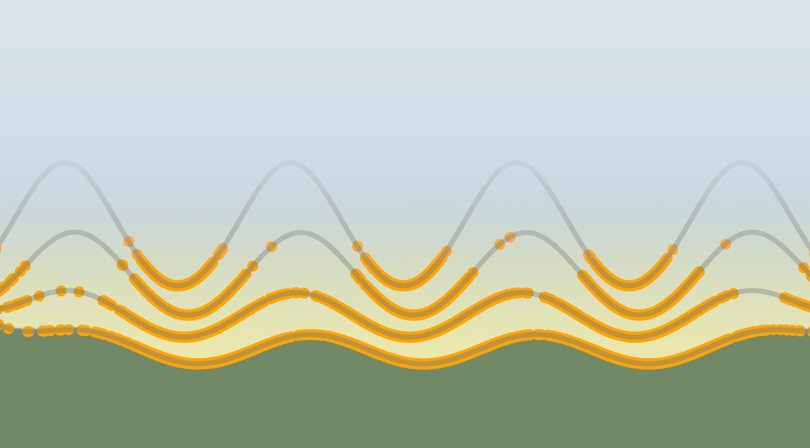
Free Energy Methods: Drug-Like Molecules and Macrocycles
Benjamin J. Ries
Defense Talk, 12/01/2022
Notes:
Introduction
Relative binding free energies
Combination of two methods.

Slide 2
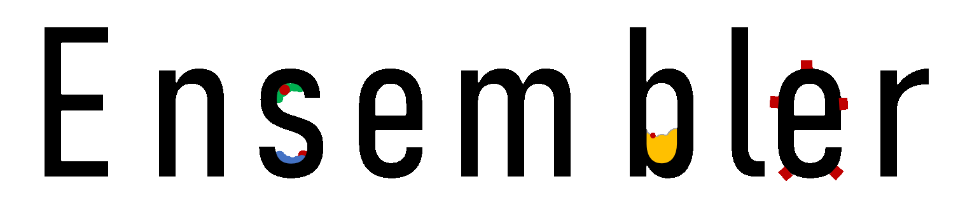
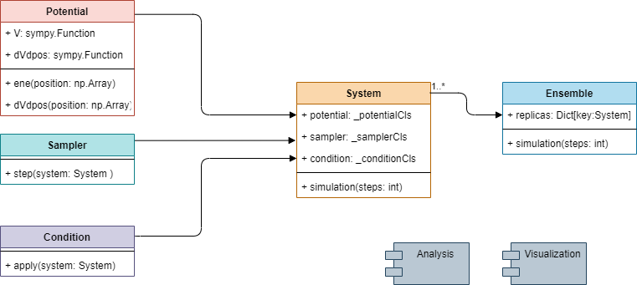
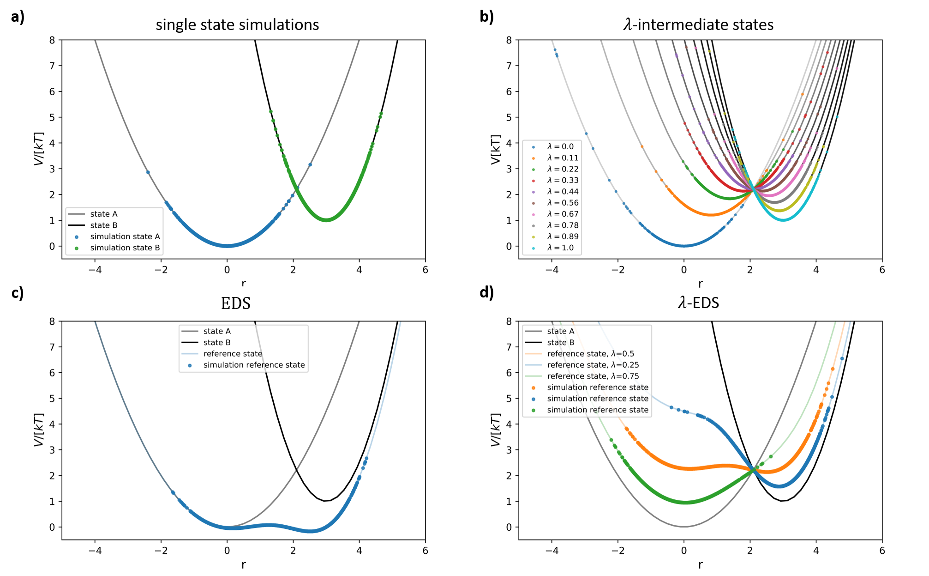
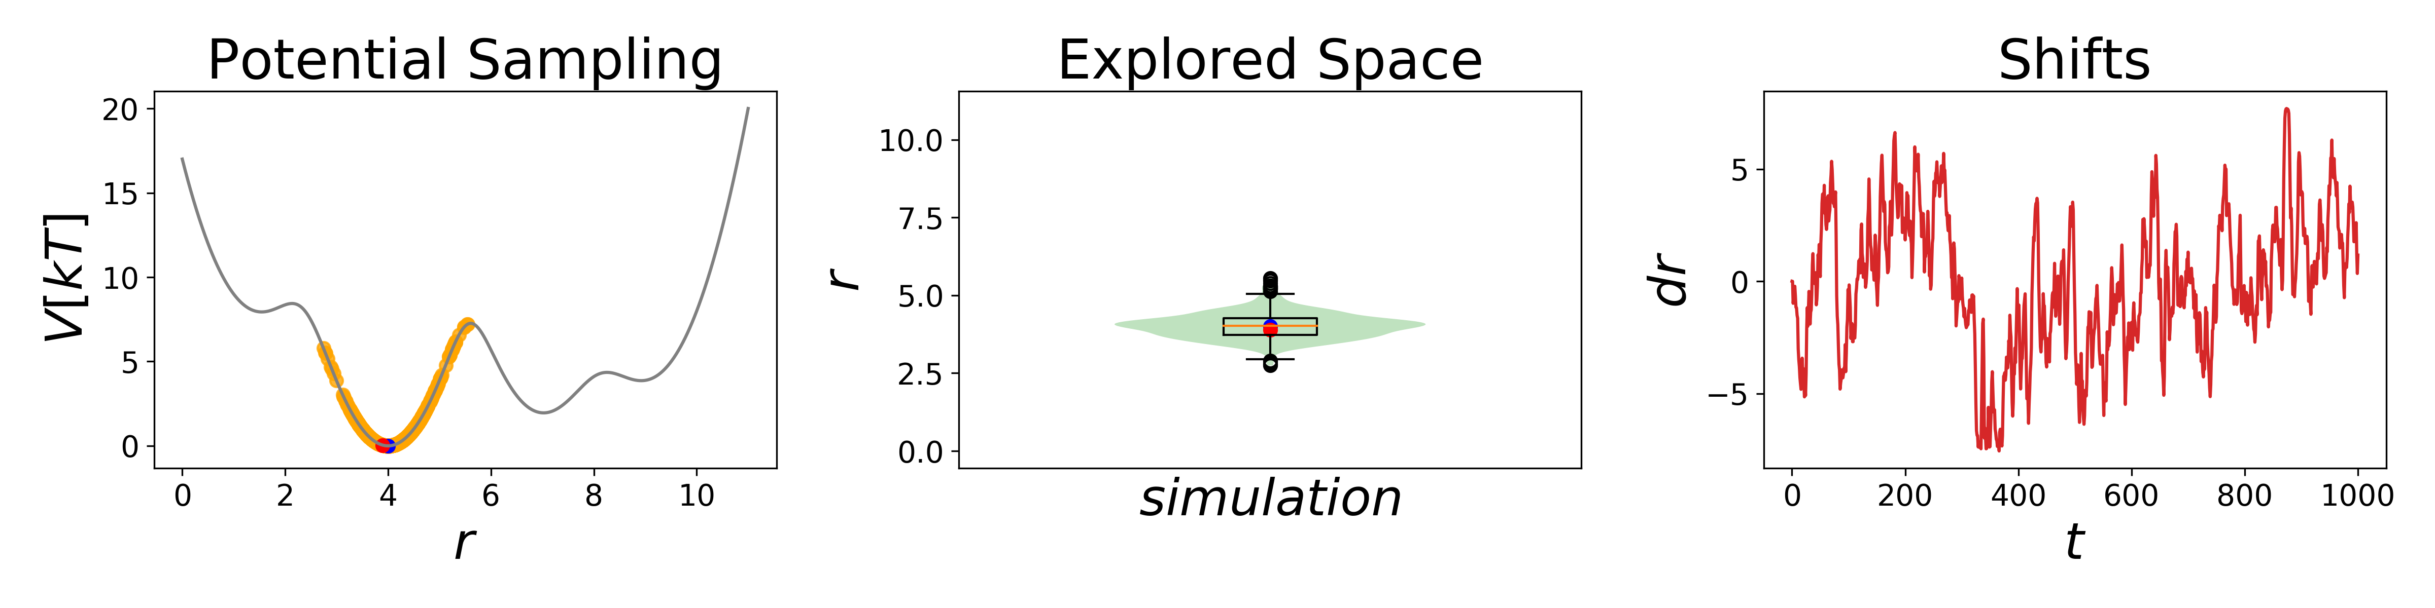
Ch 1 - A Simple Package for Fast Prototyping and Teaching Molecular Simulations

Slide 3

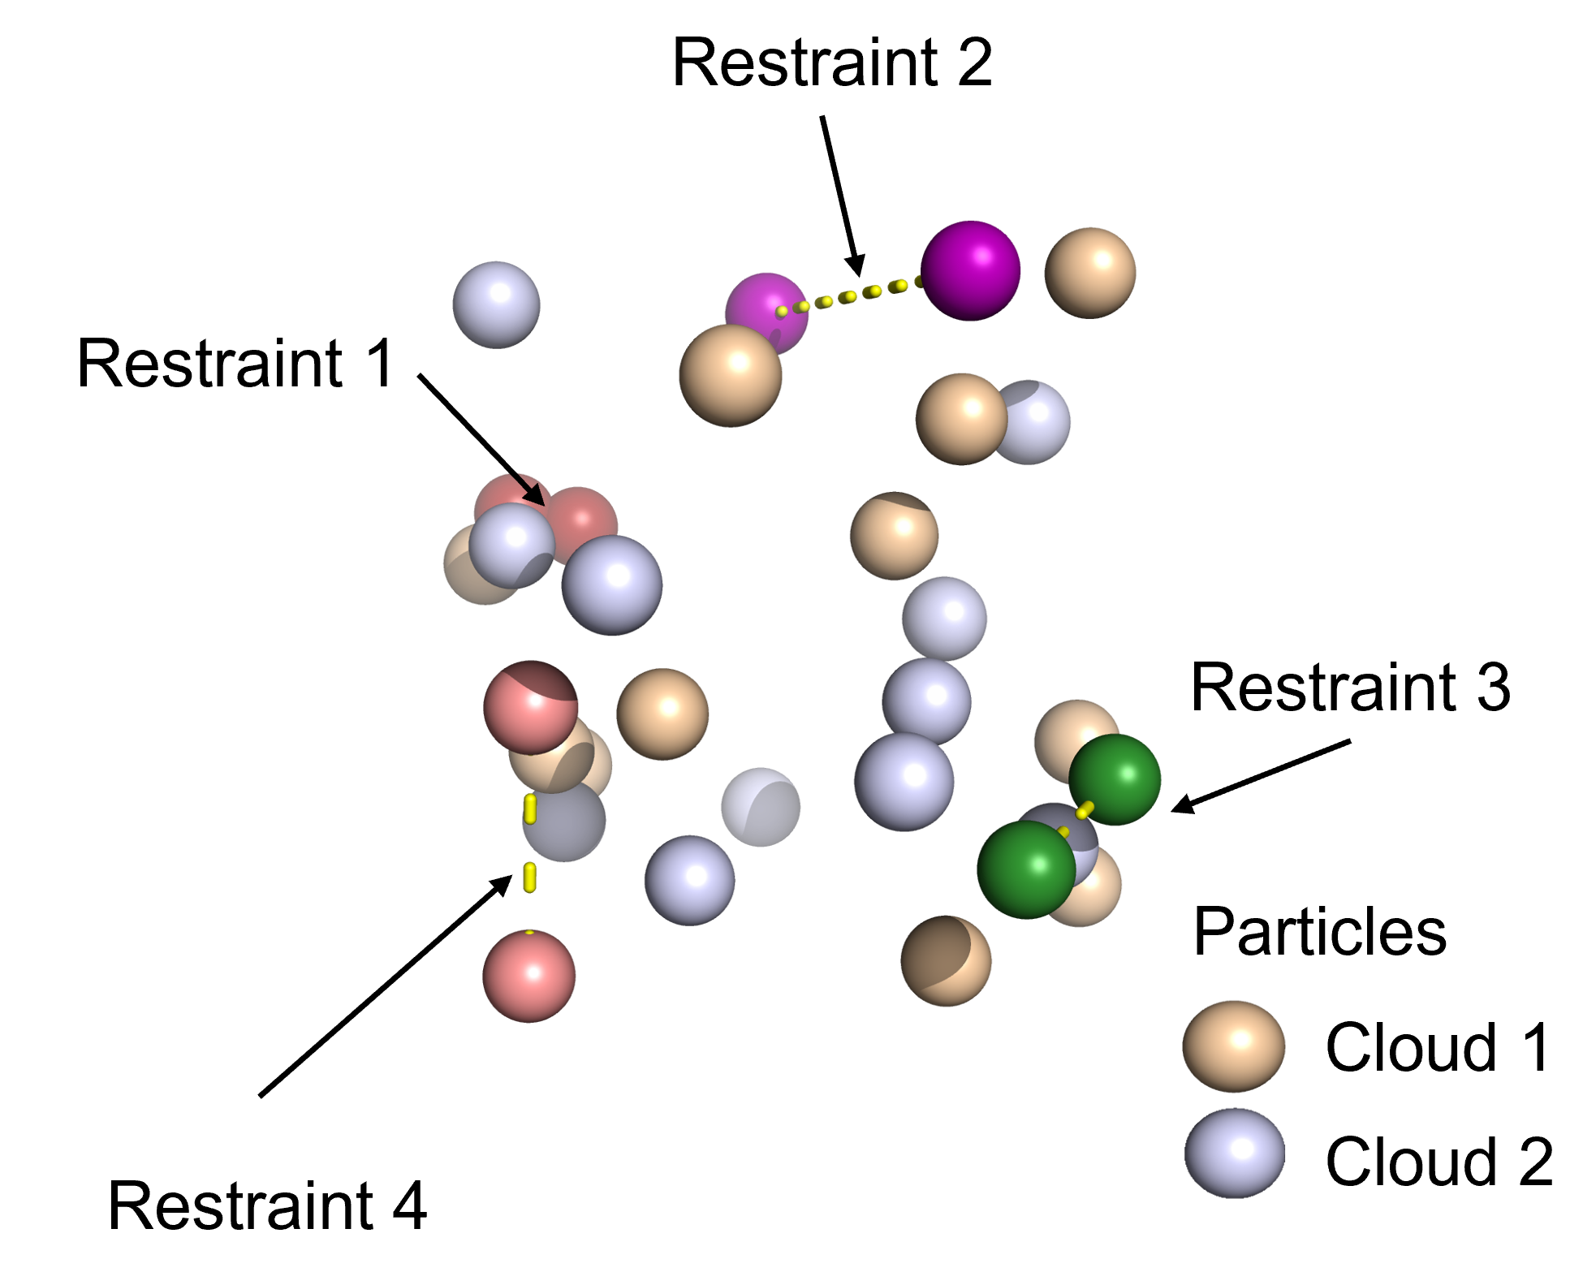
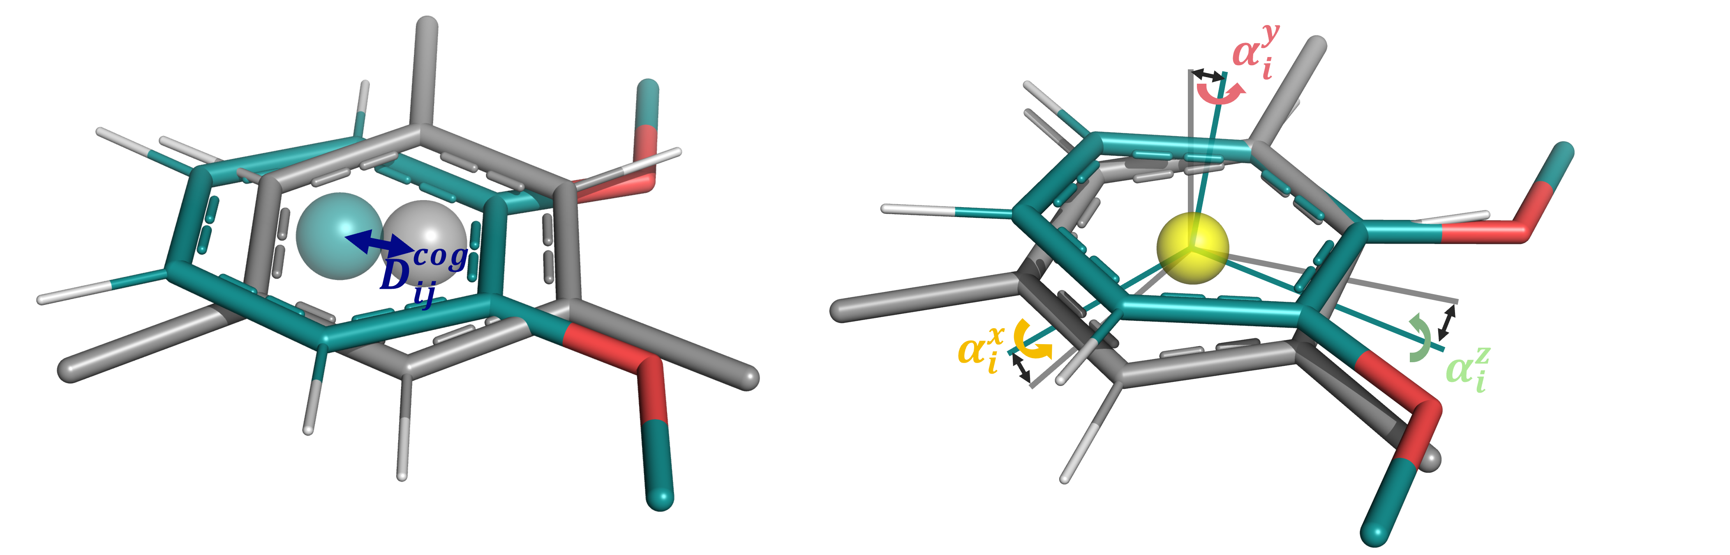
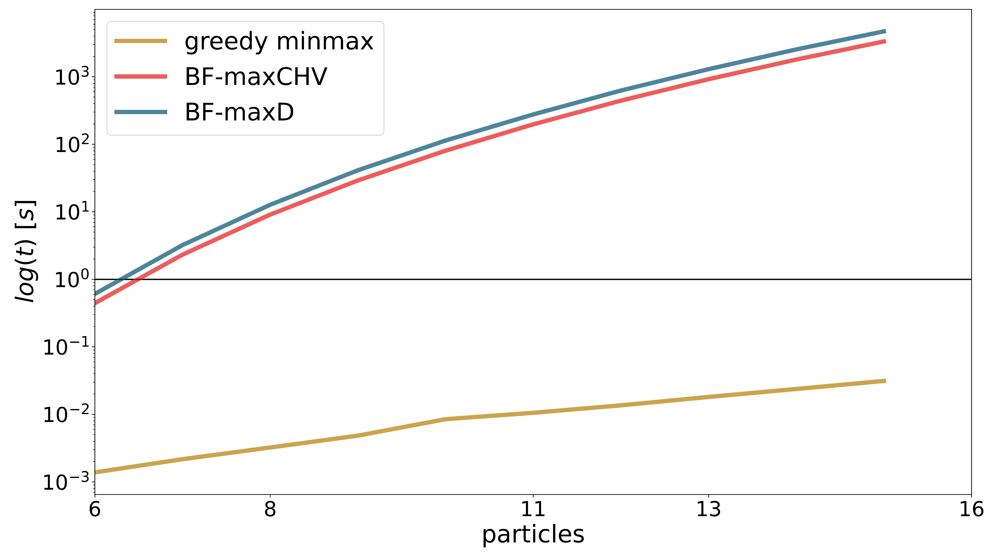
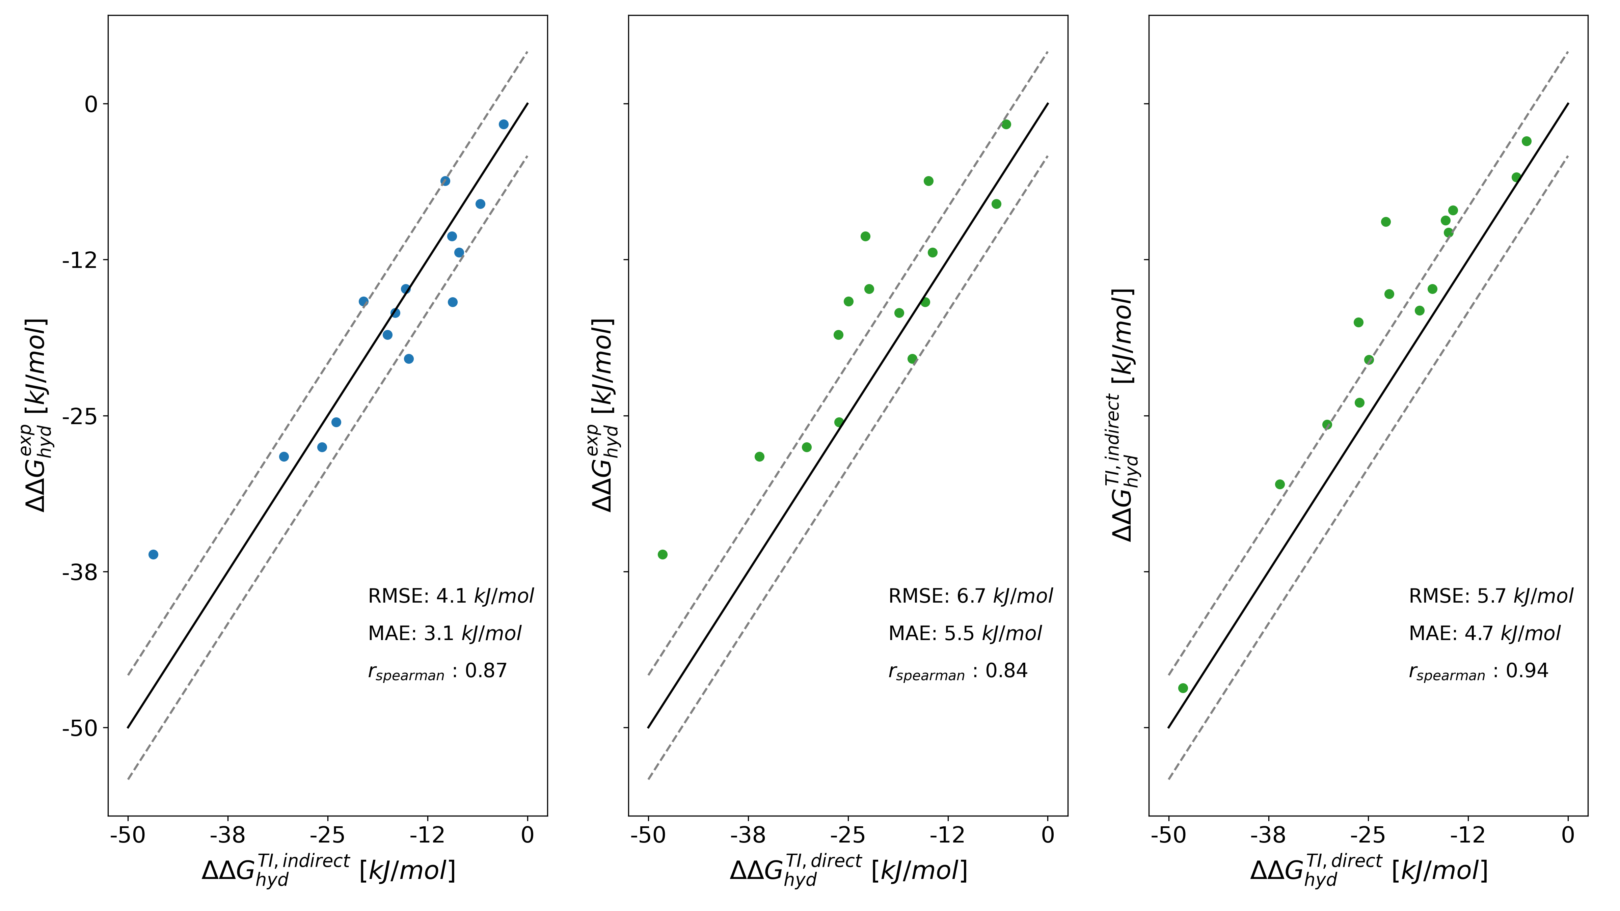
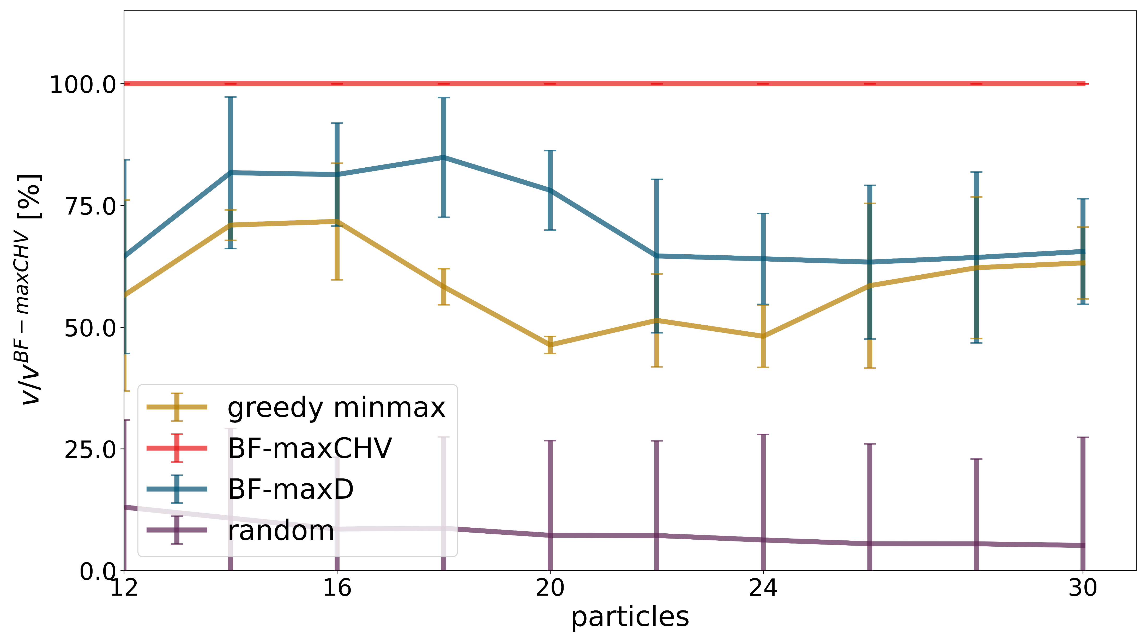
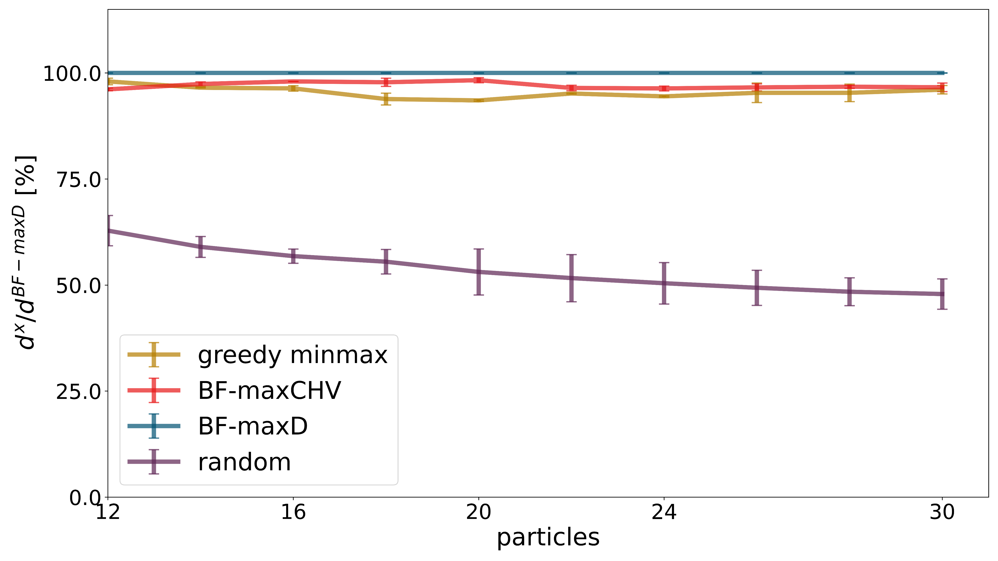
Ch 2 - A Graph-Based Approach to Select Distance Restraints in Free- Energy Calculations with Dual Topology

Slide 4
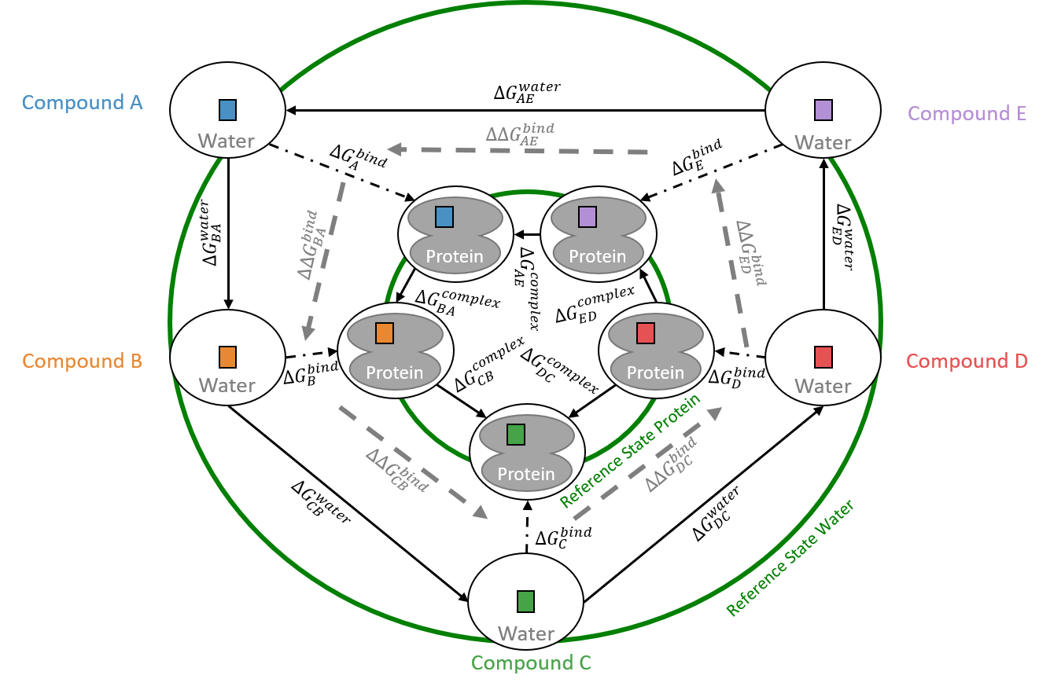
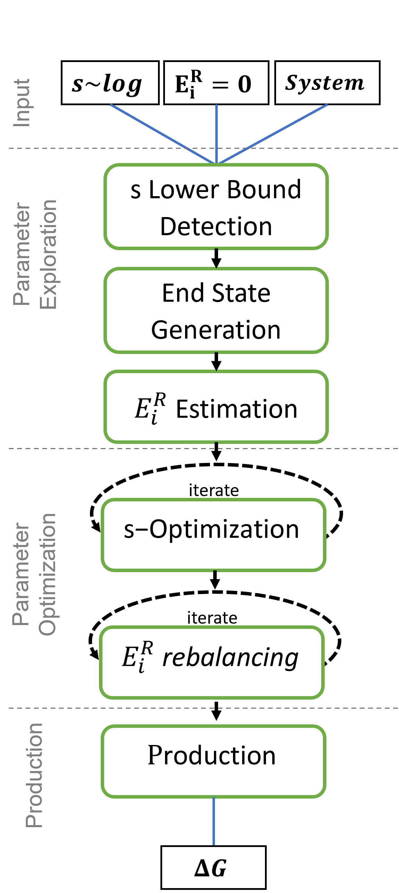
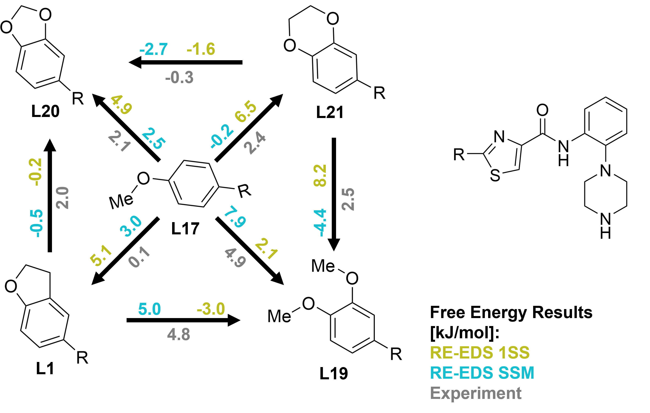
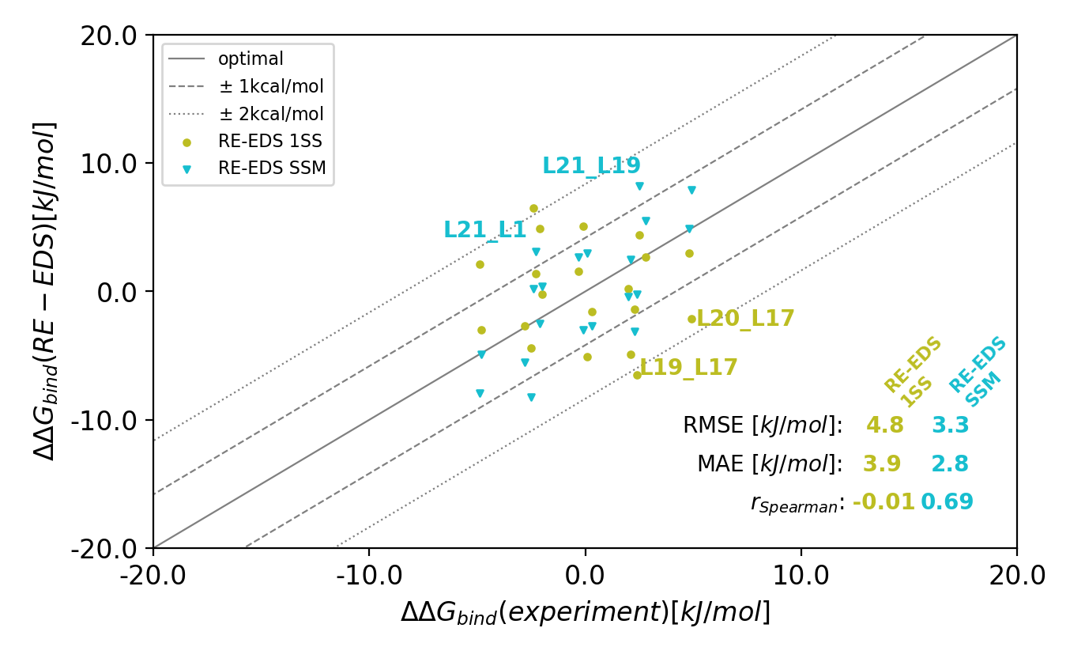
Ch 3 – Relative Free-Energy Calculations for Scaffold Hopping-Type Transformations with an Automated RE-EDS Sampling Procedure

Slide 5
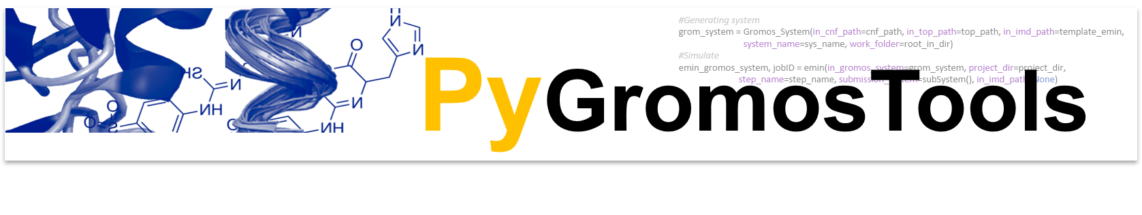
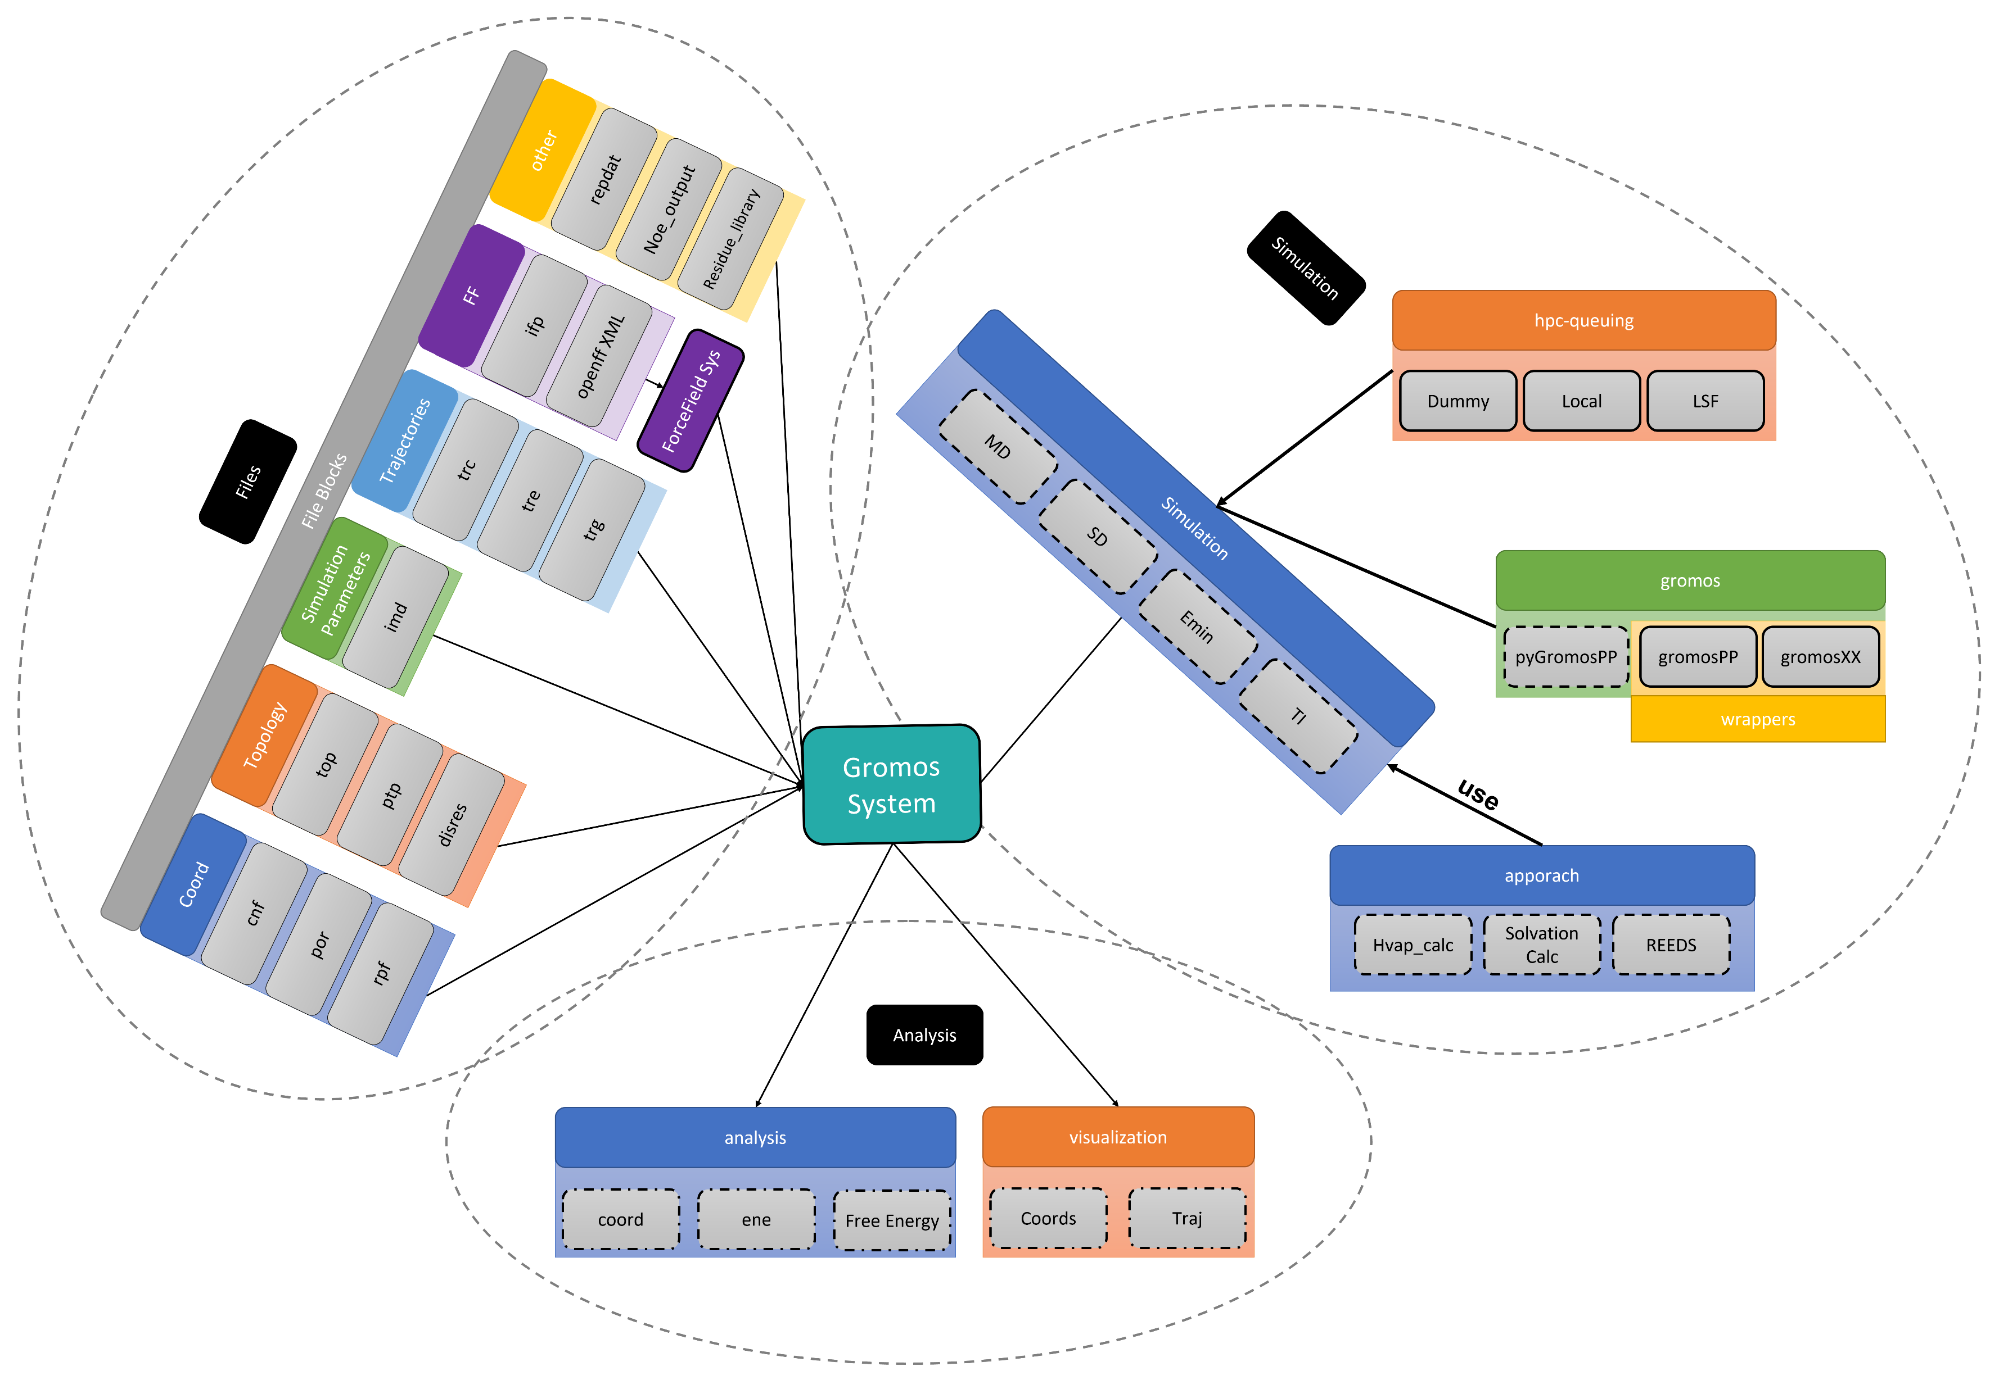
Ch 4 - A Fast and Flexible API for the Molecular Dynamics Software Package GROMOS

Slide 6
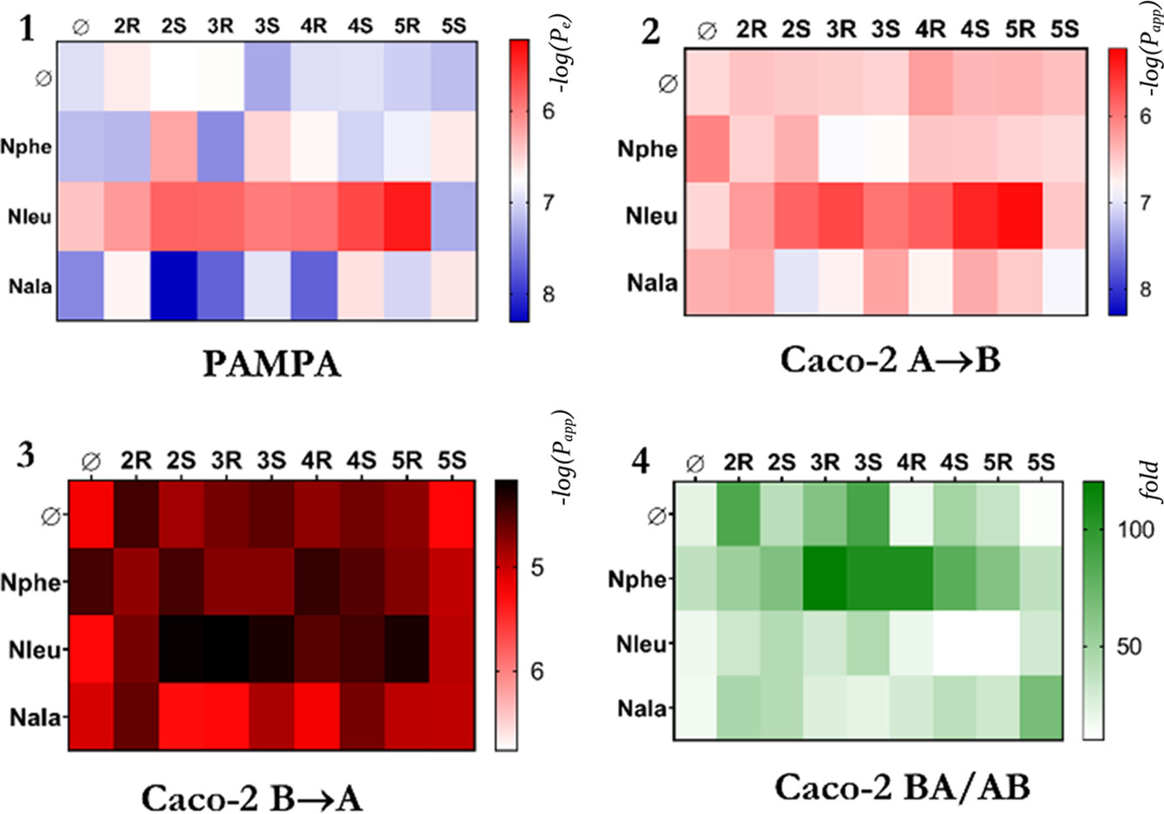
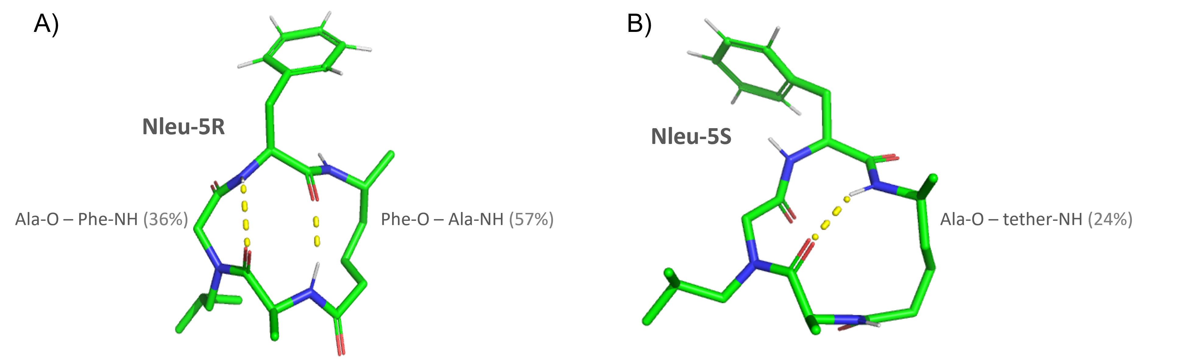
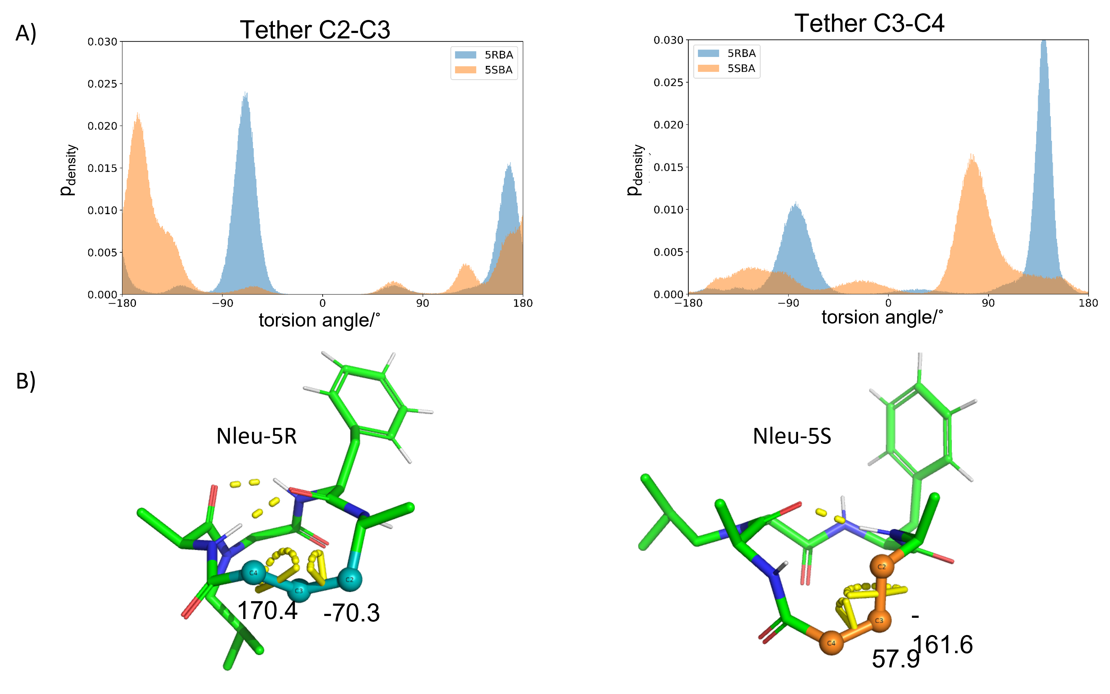
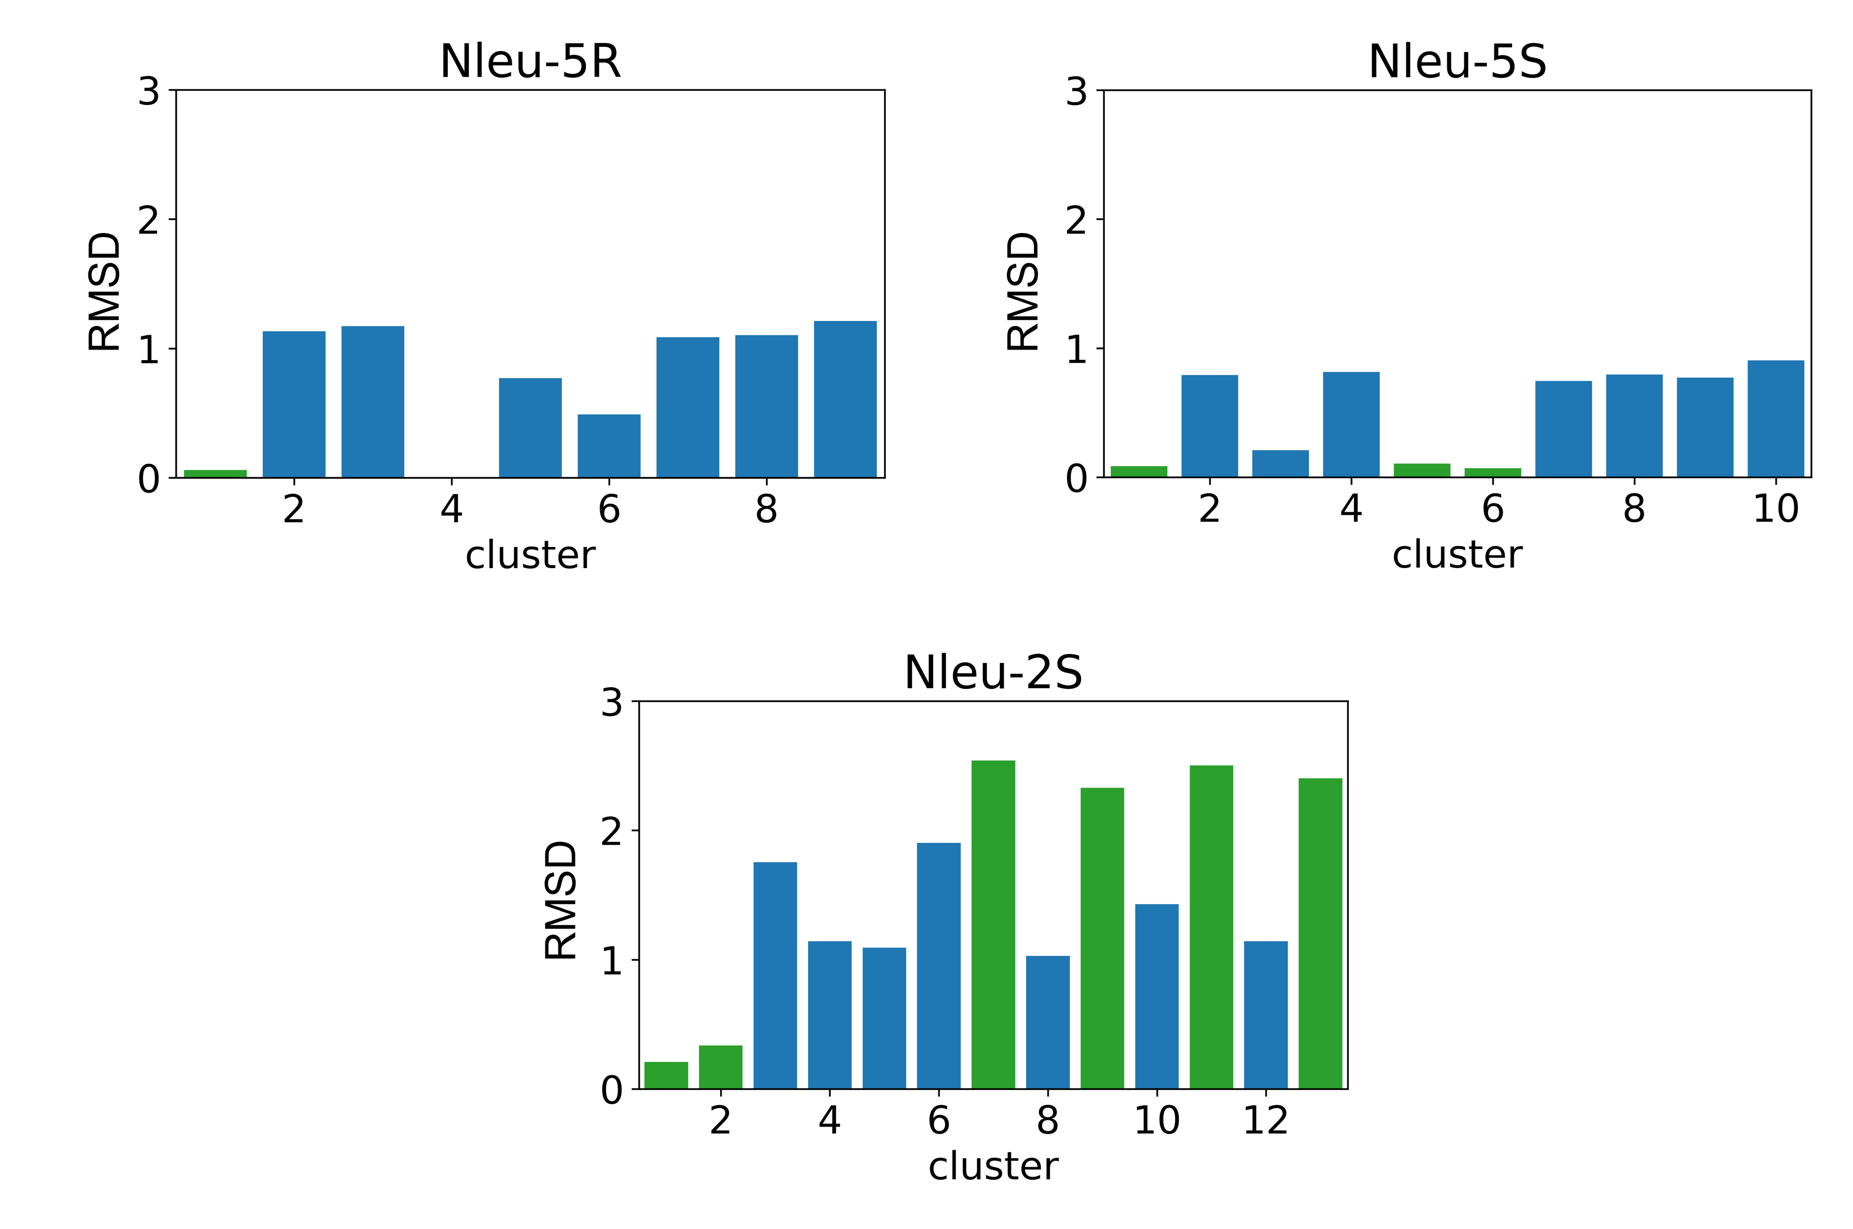
Ch 5 – Modulation of the Passive Permeability of Semipeptidic Macrocycles based on the stereochemistry change of a single atom.

Slide 7
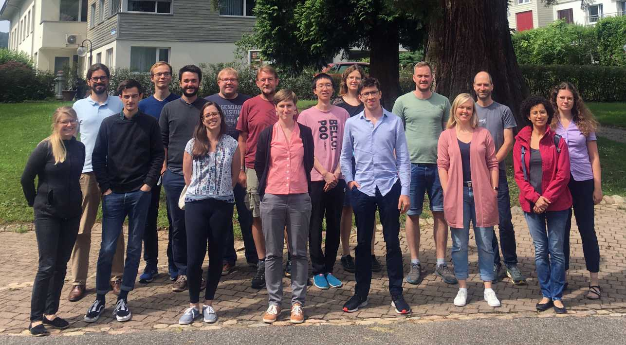

Acknowledgements
Collaboration:
Éric Marsault, Christian Comeau

Slide 8
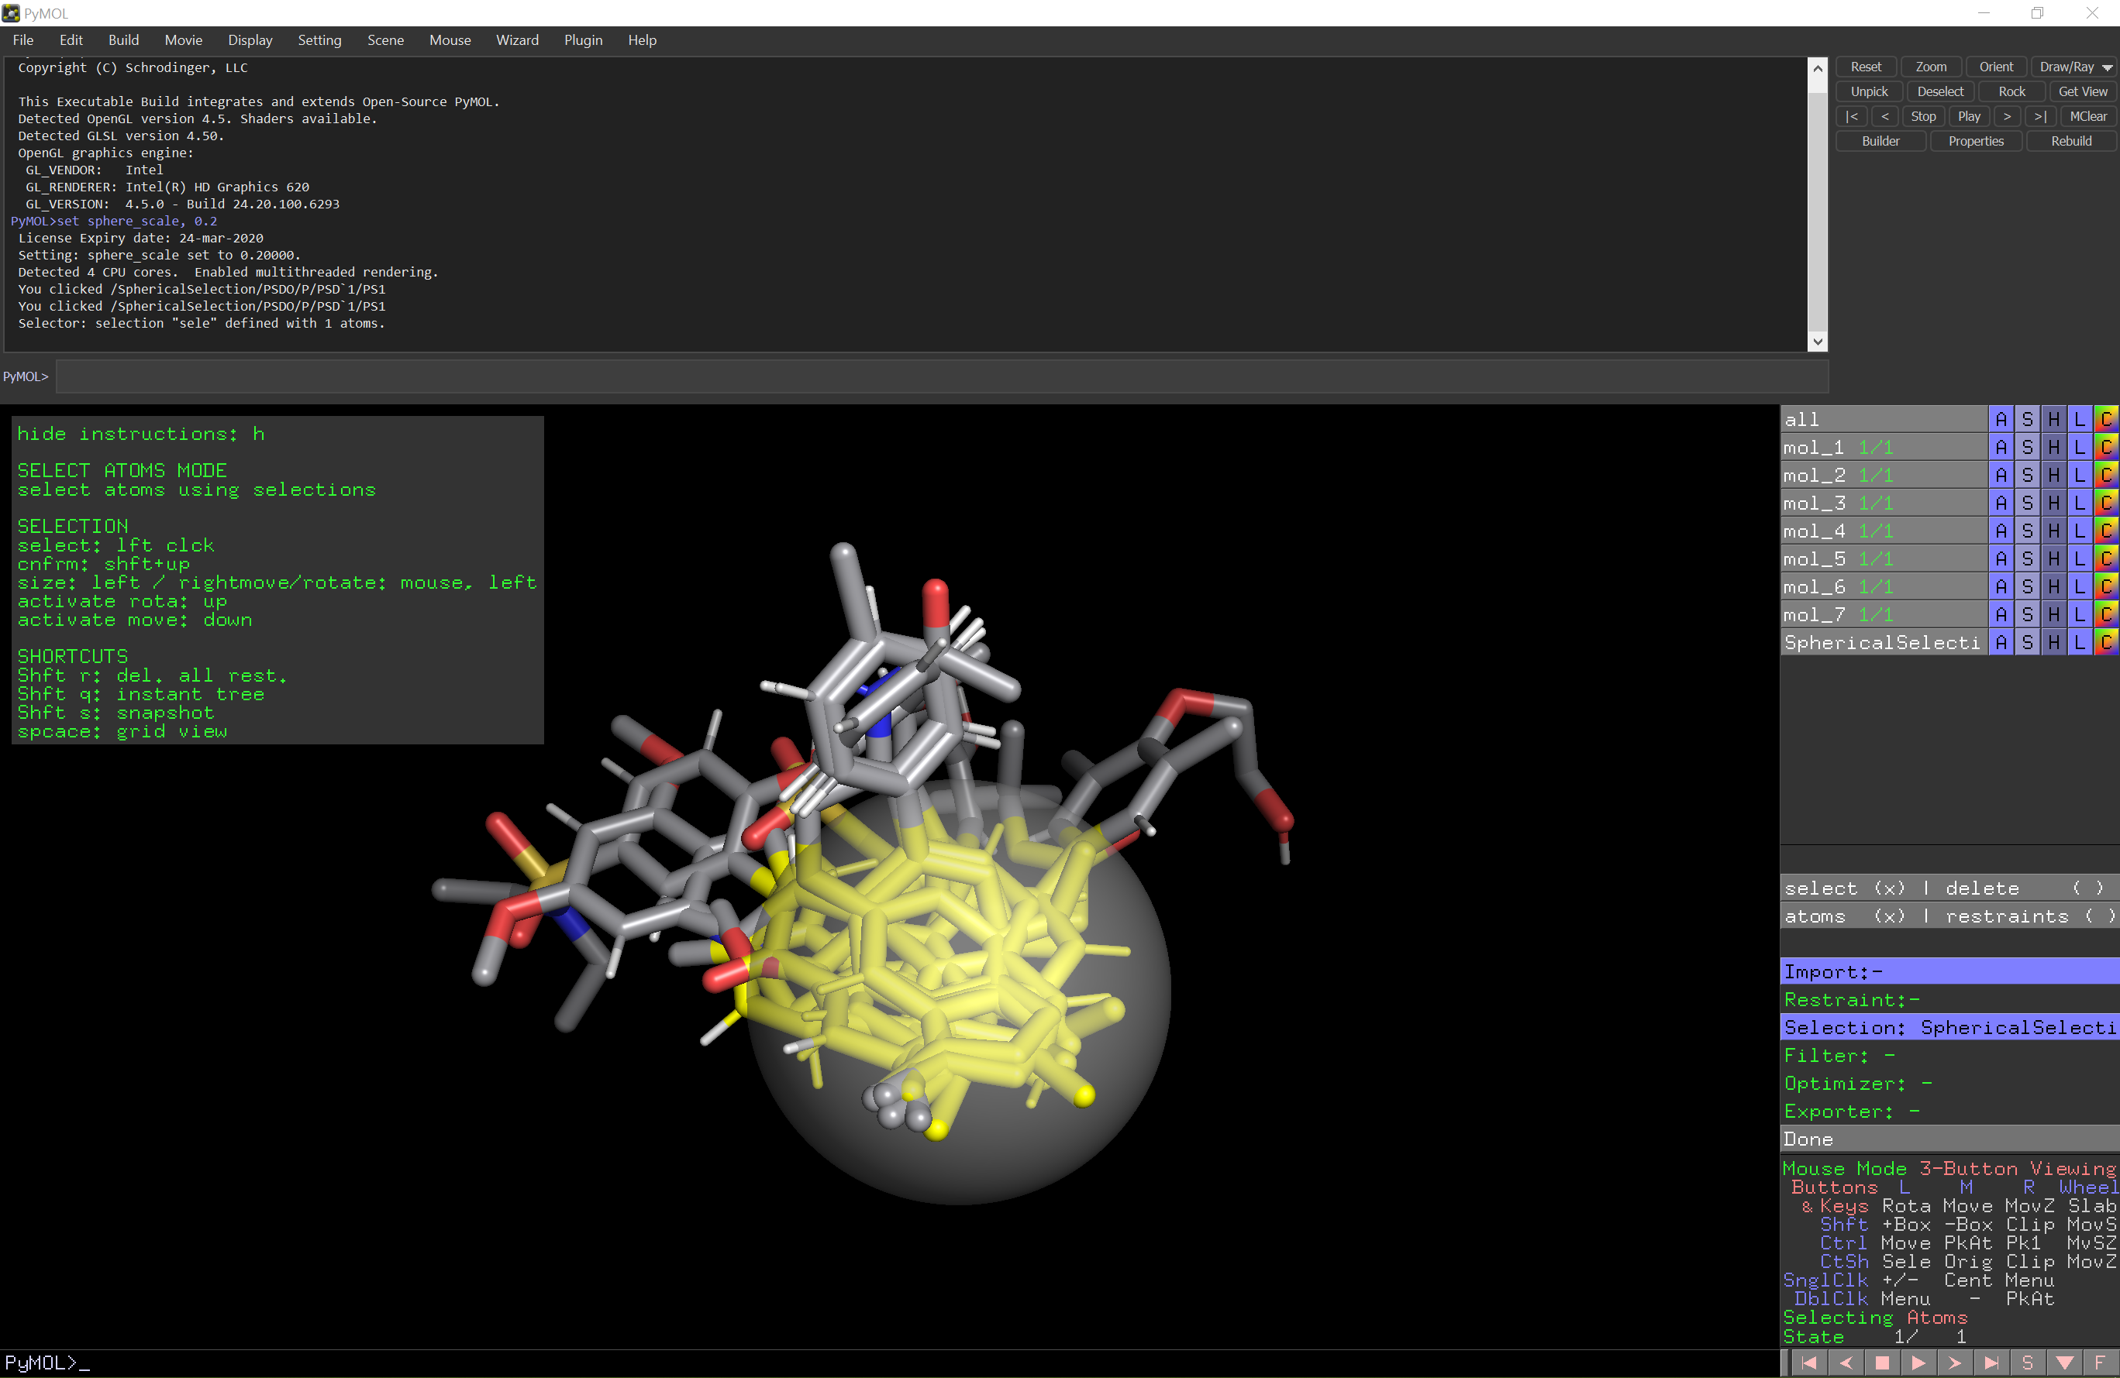
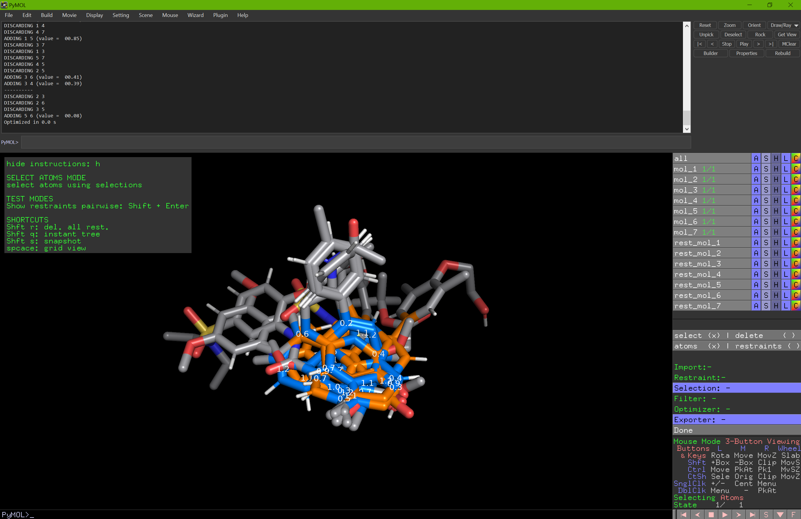
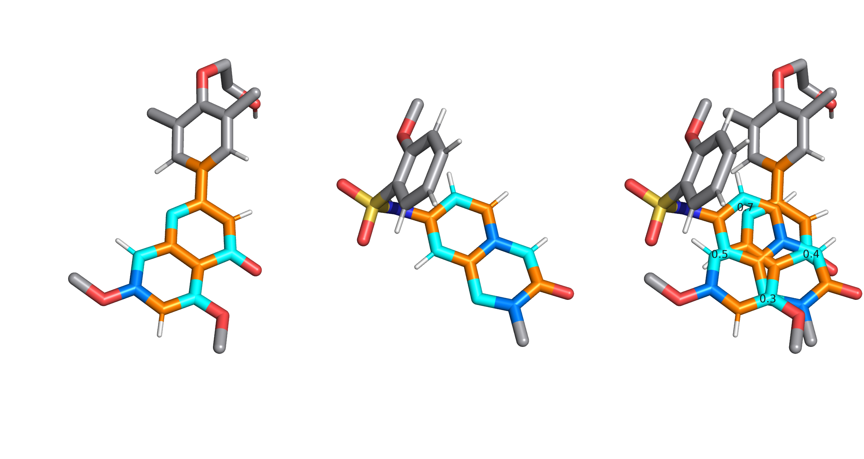
Ch 2 - Restraints
1. Selection of Core region
3. Generate optimized disres
2. Filtering
- ring structures
- atom elements
Input: atom Selection
Goal: generate distance restraint well
spreaded over molecules
Out: pairwise distance restraints
Algorithm: maximal average spanning tree
Notes:
Methods?
Motivation?
Ongoing development not – red labels

Slide 9
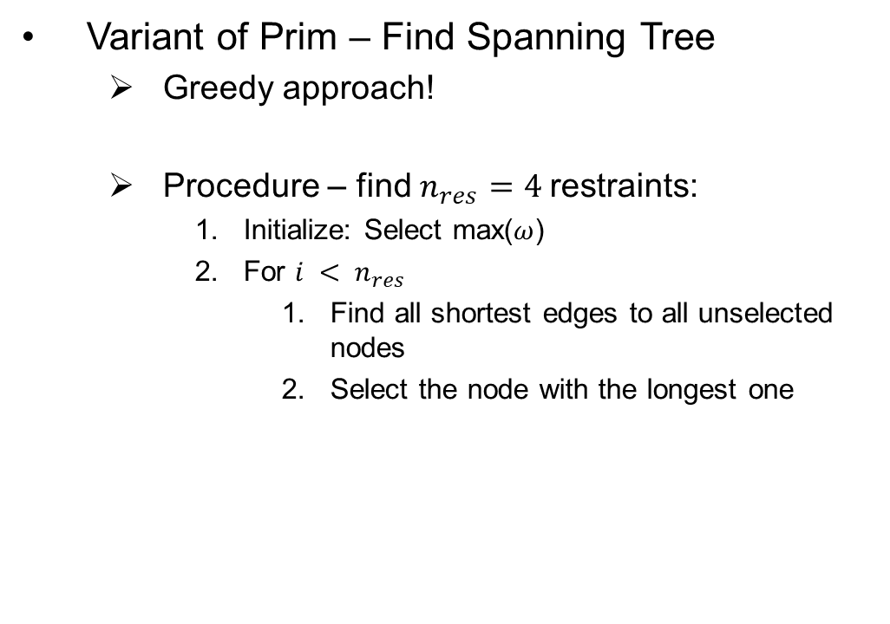
Ch 2 – Algorithm – Optimization
Variant of Prim – Find Spanning Tree
Greedy approach!
Procedure – find $n_{res}=4$restraints:
Initialize: Select max($ω$)
For $i < n_{res}$
Find all shortest edges to all unselected nodes
Select the node with the longest one
Introduction to Alogrithms, T.H. Cormen et al., MIT Press, 2009
Notes:
$$Θ=E log⁡(N)$$

Slide 10
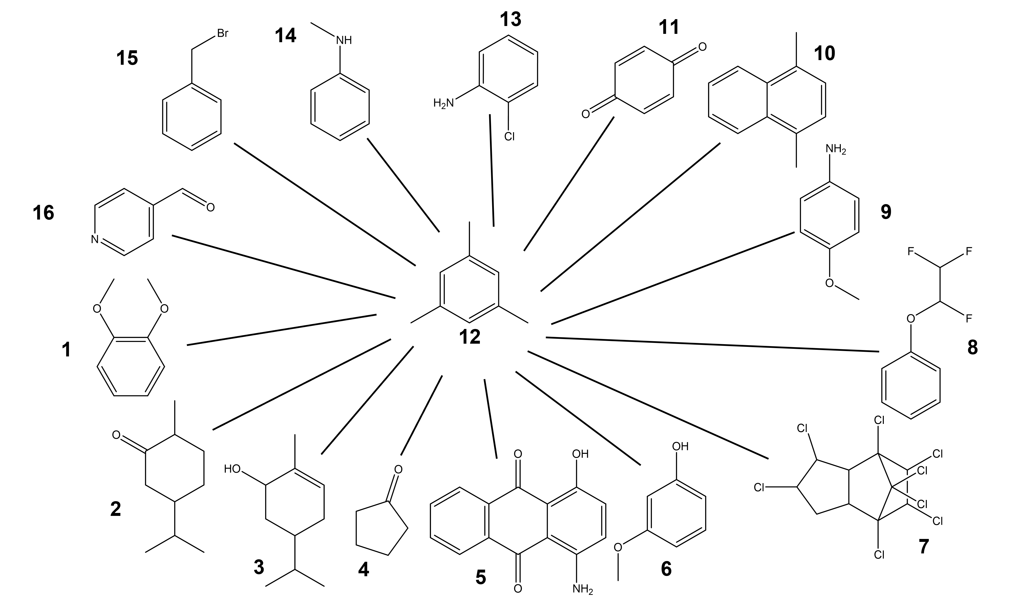
Ch 2 – State Graph

Slide 11
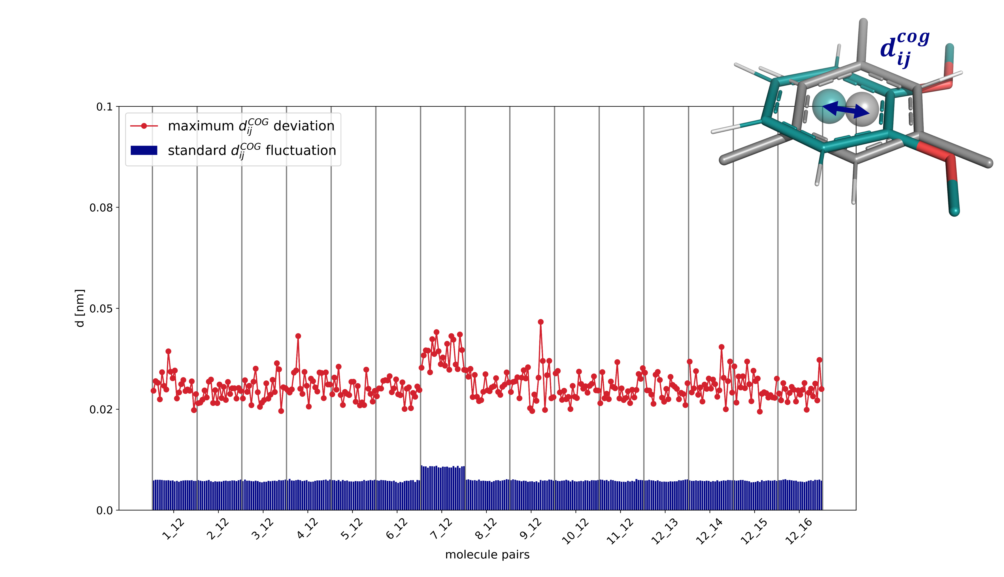
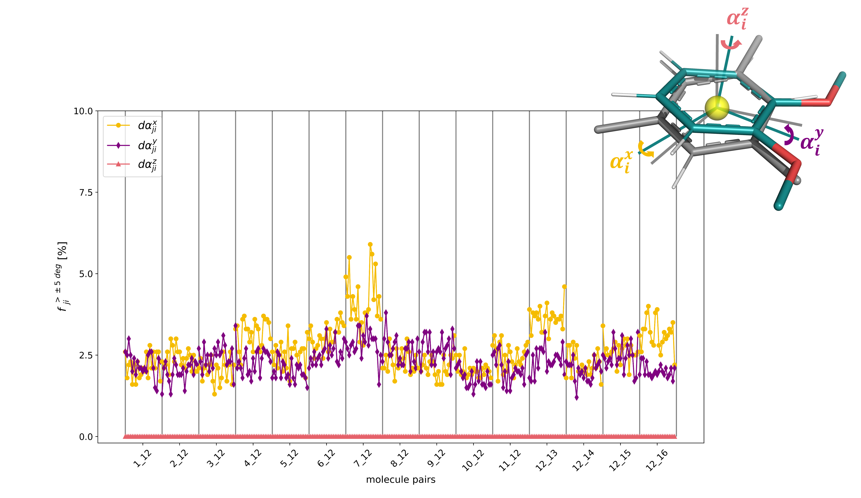
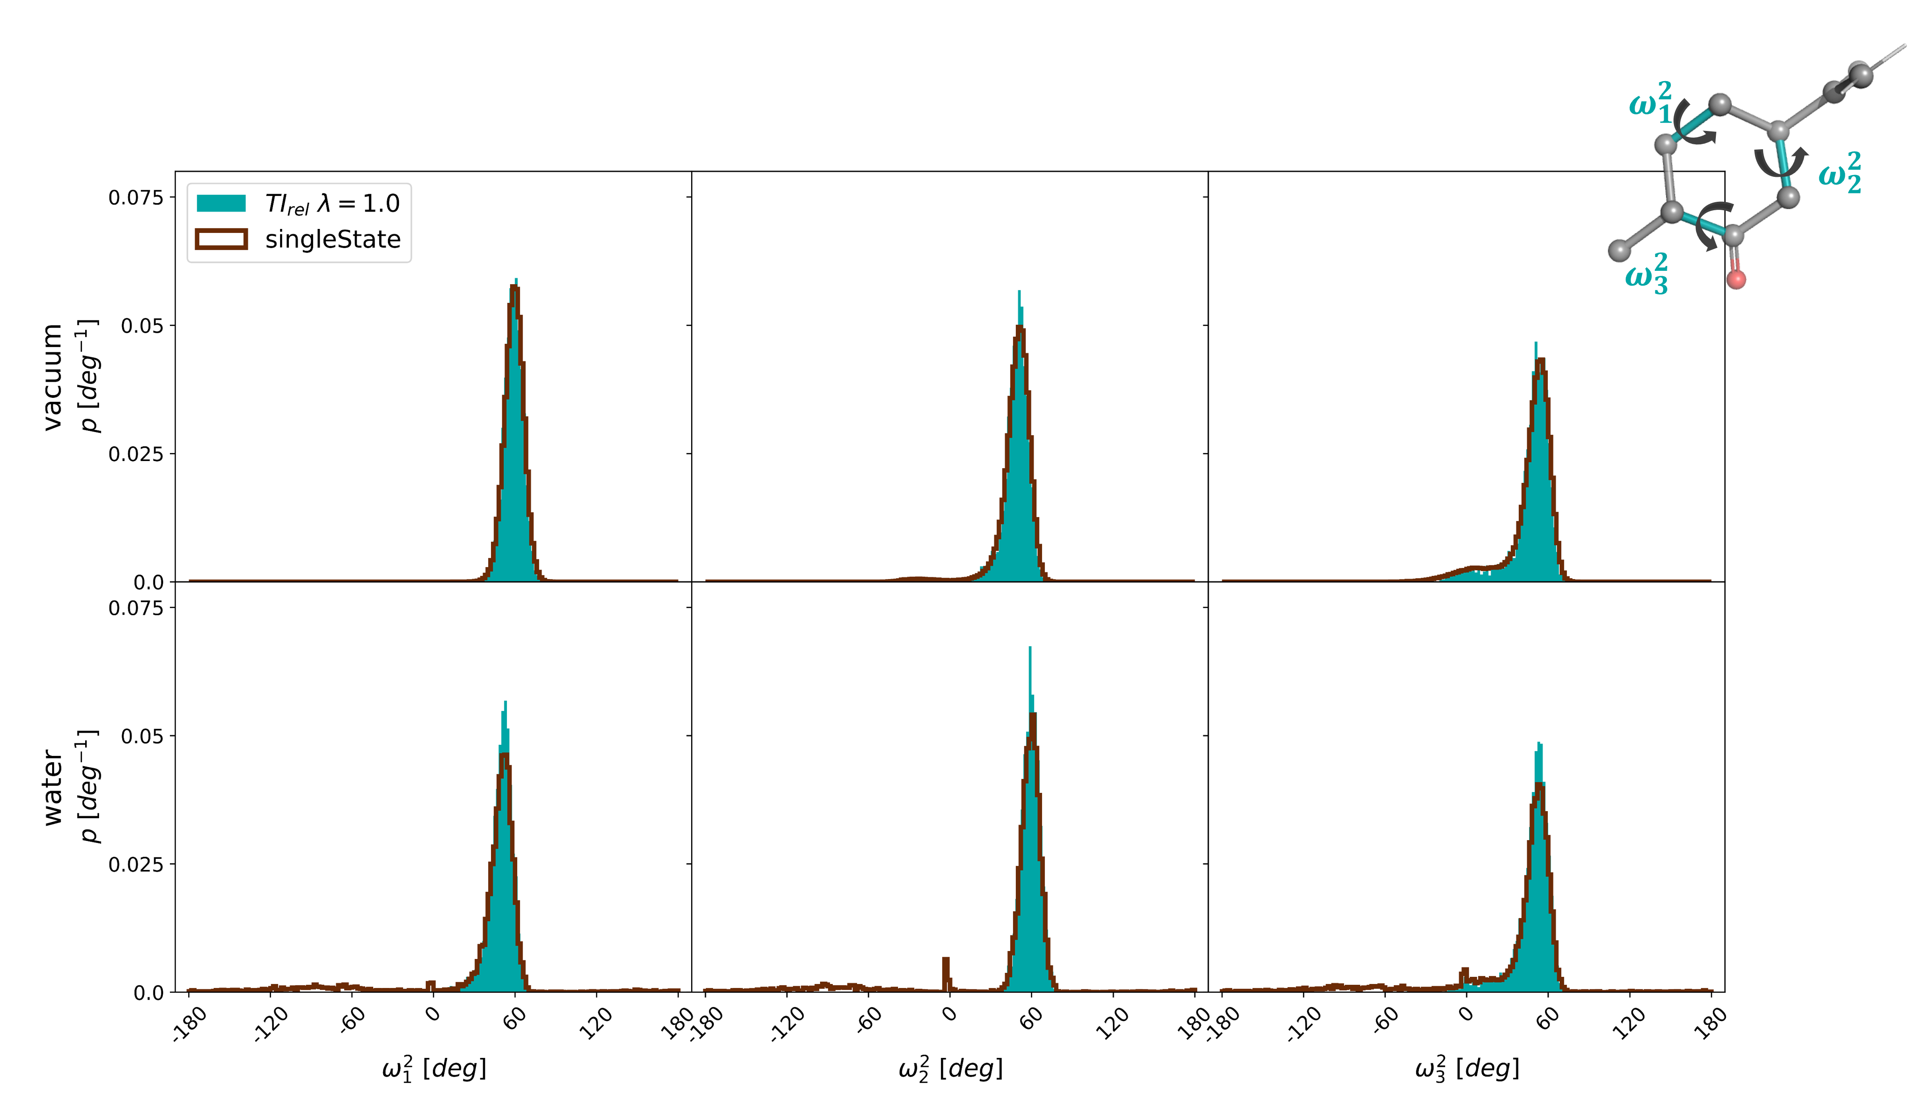
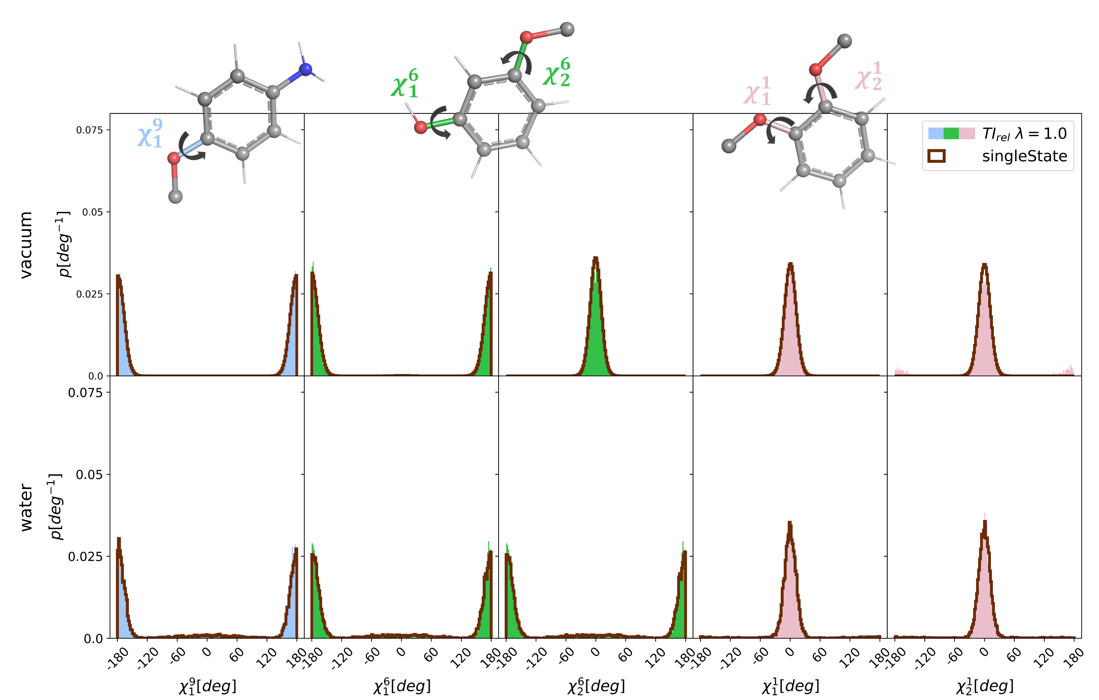
Ch 2 - Restraints

Slide 12
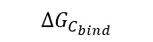
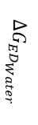
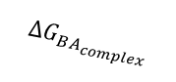
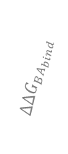
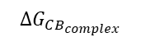
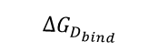
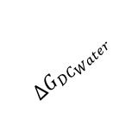


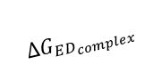
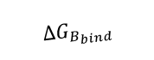
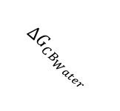
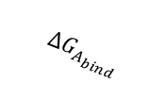
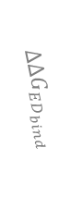
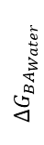
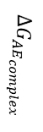
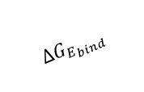
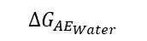

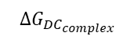
Ch 3 – Introduction – Relative Free Energy Calculations
Compound A
$$ΔG_{AE_{Water}}$$
Compound E
Water
$$ΔΔG_{AE_{bind}}$$
Water
$$ΔG_{A_{bind}}$$
$$ΔG_{E_{bind}}$$
$$ΔG_{BA_{Water}}$$
$$ΔΔG_{BA_{bind}}$$
$$ΔG_{ED_{Water}}$$
Protein
Protein
$$ΔΔG_{ED_{bind}}$$
$$ΔG_{BA_{complex}}$$
$$ΔG_{AE_{complex}}$$
$$ΔG_{ED_{complex}}$$
Compound B
$$ΔG_{B_{bind}}$$
Protein
$$ΔG_{{DC}_{complex}}$$
Protein
$$ΔG_{D_{bind}}$$
Compound D
Water
$$ΔG_{CB_{complex}}$$
Water
$$ΔΔG_{CB_{bind}}$$
Protein
$$ΔΔG_{{DC}_{bind}}$$
$$ΔG_{CB_{Water}}$$
$$ΔG_{{DC}_{Water}}$$
Reference states
$$ΔG_{C_{bind}}$$
Water
Compound C
Multiple free energies from a single simulation: extending enveloping distribution sampling to nonoverlapping phase-space distributions, C. Christ et al., JCP, 2008
Notes:
How do we want to connect the graph for pairwise methods? Many ways possible this is only one example/

Slide 13
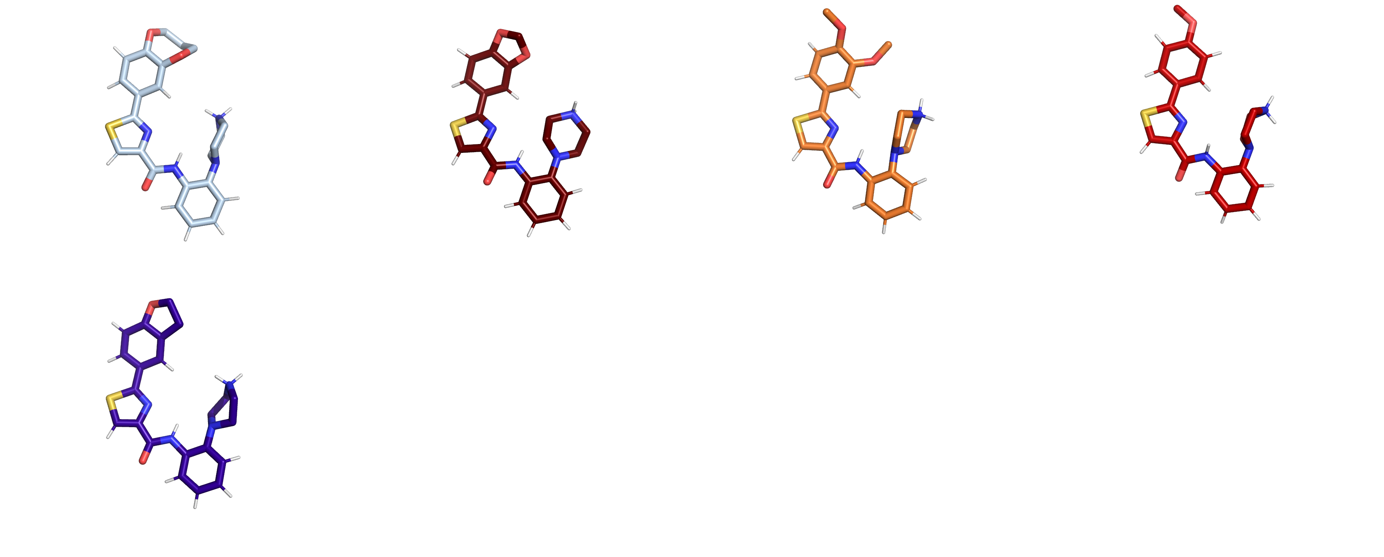
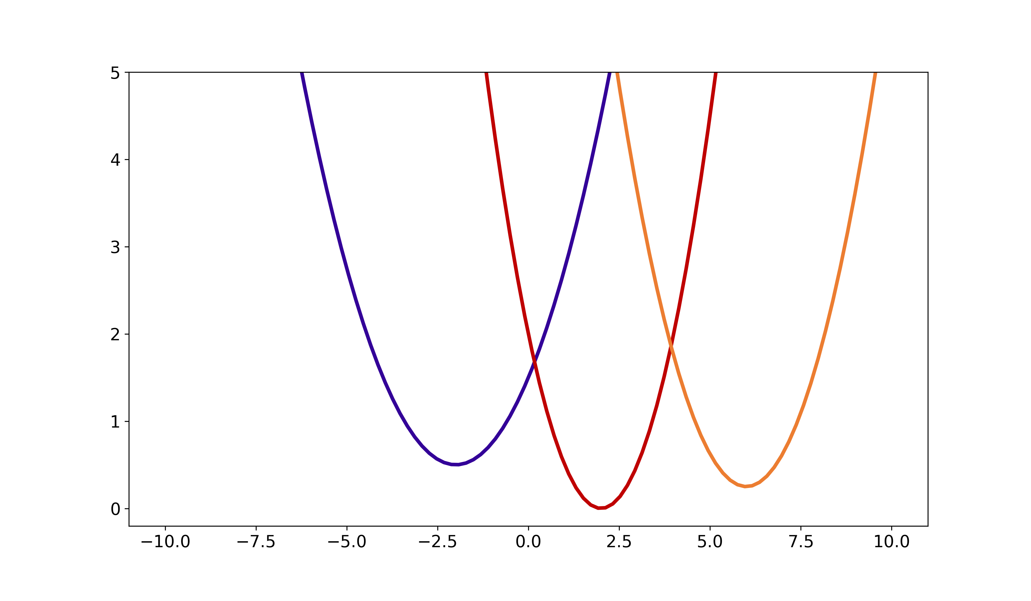




Ch 3 – Enveloped Distribution Sampling (EDS)
EDS reference state
Build reference potential $V_{R}$ by enveloping all states and their partition functions
→ System defined reference state
N-state generalization
$$V_{R}\left(r\right)=−\frac{1}{βs}\ln\left(\sum_{i}^{N}{e^{−βs\left(V_{i}−E_{i}^{R}\right)}}\right)$$
$$V_{pot}$$
$$r$$
Multiple free energies from a single simulation: extending enveloping distribution sampling to nonoverlapping phase-space distributions, C. Christ et al., JCP, 2008
Notes:
Reference State and momentum scaling Crucial determining the Sampling!
can treat multiple state
More describe equations
Check out reweigthing or 2xZwanzig equation ? Ensemble averages – two logs?

Slide 14




Ch 3 – Enveloped Distribution Sampling (EDS)
$$V_{R}\left(r\right)=\frac{1}{βs}\ln\left(\sum_{i}^{N}{e^{−βs\left(V_{i}−E_{i}^{R}\right)}}\right)$$
Smoothing Parameter s
Decreases the energy barriers
Energy Offset $E_{i}^{R}$
Gives equal weighting to each state
Multiple free energies from a single simulation: extending enveloping distribution sampling to nonoverlapping phase-space distributions, C. Christ et al., JCP, 2008
Notes:
Parametres
0/1 – instead of A/B

Slide 15



Ch 3 – Enveloped Distribution Sampling (EDS)
Relative free energy difference
$$ΔG_{BA_{env}}=ΔG_{BR_{env}}+{ΔG}_{RA_{env}}$$
$$=−k_{B}T\ln{{\left\langle e^{−\frac{V_{A}−V_{R}}{k_{B}T}}\right\rangle }_{R}}+k_{B}T\ln{{\left\langle e^{−\frac{V_{A}−V_{R}}{k_{B}T}}\right\rangle }_{R}}$$
Compound A
env
env
$$Δ{G_{RA}}_{env}$$
R
env
env
$$Δ{G_{BR}}_{env}$$
Compound B
env
env
Multiple free energies from a single simulation: extending enveloping distribution sampling to nonoverlapping phase-space distributions, C. Christ et al., JCP, 2008
Notes:
Reference State and momentum scaling Crucial determining the Sampling!
can treat multiple state
More describe equations
Check out reweigthing or 2xZwanzig equation ? Ensemble averages – two logs?

Slide 16



Ch 3 – Replica-Exchange EDS (RE-EDS)
Replica exchange enveloping distribution sampling (RE-EDS): A robust method to estimate multiple free-energy differences from a single simulation, Sidler et al., JCP 2017

Slide 17









Ch 3 – RE-EDS Workflow
$$s\sim log$$
$$E_{i}^{R}=0$$
$$System$$
Input
Occurrence Sampling
s Lower Bound Detection
Parameter Exploration
End State Generation
Replica s-parameters
$E_{i}^{R}$ Estimation
Parameter
Optimization
iterate
$$\text{s}\text{−}\text{O}\text{ptimization}$$
$$\text{P}\text{roduction}$$
Production
$$ΔG$$

Slide 18

Ch 3 – RE-EDS Workflow
$$s\sim log$$
$$E_{i}^{R}=0$$
$$System$$
End State Coordinates
Input
Start coordinates
s Lower Bound Detection
Parameter Exploration
End State Generation
$E_{i}^{R}$ Estimation
Parameter
Optimization
iterate
$$\text{s}\text{−}\text{O}\text{ptimization}$$
$$\text{P}\text{roduction}$$
Production
$$ΔG$$
Single state MD

Slide 19



Ch 3 – RE-EDS Workflow – 1SS vs SSM
1 Starting State (1SS)
Starting State Mixing (SSM)

Slide 20



Ch 3 – RE-EDS Workflow – Energy Offsets
$$s\sim log$$
$$E_{i}^{R}=0$$
$$System$$
Input
s Lower Bound Detection
Parameter Exploration
End State Generation
$E_{i}^{R}$ Estimation
Parameter
Optimization
iterate
$$\text{s}\text{−}\text{O}\text{ptimization}$$
$$\text{P}\text{roduction}$$
Production
$$ΔG$$
Replica exchange enveloping distribution sampling (RE-EDS): A robust method to estimate multiple free-energy differences from a single simulation, Sidler et al., JCP 2017

Slide 21





Ch 3 – RE-EDS Workflow – RE-Bottleneck
Initial
Optimization Step 5

Slide 22


Ch 3 – RE-EDS Optimization

Slide 23


Ch 4 – PyGromosTools examples

Slide 24

Ch 4 – PyGromosTools examples

Slide 25


Ch 5 – Cyclic Peptides

